Slide 1






SQLdm Today
Sunday, November 19, 2006
9:00 AM
Status Summary
Tasks
Critical
7 of 25 servers are in critical condition.
Restart TMISKELLYLAPTOP\SQLSERVER2005
Defragment tables on sqldmbuild
7 servers are in critical condition
5 servers have crossed a warning threshold
3 servers are in maintenance mode
10 servers are operating normally
Alerts (last 24 hours)
 | Time | Server | Message
 | 11/19/2006 9:00:50 AM | sqldmbuild | Something has gone terribly wrong
 | 11/19/2006 8:55:50 AM | TMISKELLYLAPTOP | This can’t be good
 | 11/19/2006 8:45:50 AM | TMISKELLYLAPTOP | You probably want to check this server out
 | 11/19/2006 8:45:50 AM | TEST | A previous alert has been cleared
 | 11/19/2006 8:30:50 AM | TEST | TEST has been put in maintenance mode
Common Tasks
Add Server(s)
Add new monitored SQL Servers
Monitor Alerts
Monitor alerts raised by SQLdm in real-time
Manage Tasks
Create and track critical work tasks
Generate Reports
Create standard or custom trend reports

Slide 2

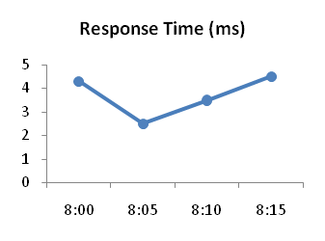
My View – All Servers
sqldmtest01
sqldmtest02
sqldmtest03
sqldmtest01
SQL Server 2005 SP1
Build 9.00.2047.00
sqldmtest03
SQL Server 2005 SP1
Build 9.00.2047.00
Response Time: | 70 ms
User Sessions: | 10
Avg. CPU Usage: | 7%
Memory Usage: | 66 MB
SQL Disk I/O: | 20/70
Response Time: | 70 ms
User Sessions: | 10
Avg. CPU Usage: | 7%
Memory Usage: | 66 MB
SQL Disk I/O: | 20/70
sqldmtest04
sqldmtest05
sqldmtest06
sqldmtest05
SQL Server 2005 SP1
Build 9.00.2047.00
sqldmtest06
SQL Server 2005 SP1
Build 9.00.2047.00
Response Time: | 70 ms
User Sessions: | 10
Avg. CPU Usage: | 7%
Memory Usage: | 66 MB
SQL Disk I/O: | 20/70
Response Time: | 70 ms
User Sessions: | 10
Avg. CPU Usage: | 7%
Memory Usage: | 66 MB
SQL Disk I/O: | 20/70

Slide 3
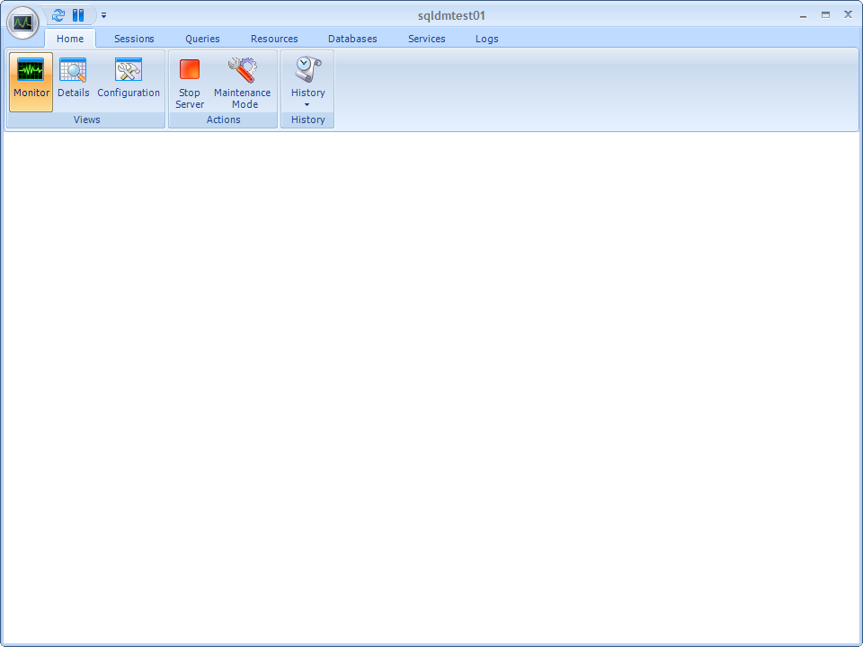
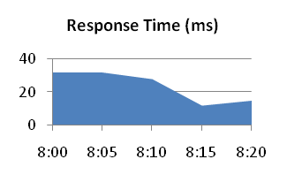
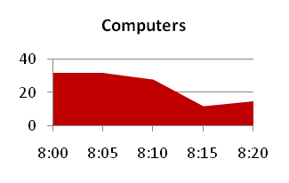










sqldmtest01
Recent Trends (Last 30 Minutes)
Critical
Active Alerts
3 Critical
0 Warning
Sessions
Processor
Memory
Disk
Status Overview
Response Time
(ms)
SQL Processes
SQL Memory Usage
Databases
Sessions
409 MB
8
5
24
0 1.99 GB
Queries
Buffer Cache
Data Files
Resources
.20
Pkt/s
Locks
Size: 80.7 MB
Files:
8
Size:
249 MB
Computers
5
3.81
W/s
Hit Rate
0.00
Sync W/s
Databases
99.8%
52%
Services
2
1.44 Pkt/s
0.00
R/s
0 100%
Procedure Cache
0.00
Sync R/s
Properties
Processor Queue
Size: 314 MB
Log Files
Version: | SQL Server 2005
Edition: | Developer
Service Pack: | SP1
Host OS: | Windows XP
User Sessions
1
Hit Rate
Files:
8
Size:
33.7 MB
3
1.46
Bat/s
0 5
2.50
Cmp/s
89.8%
0.00
Flush/s
0 100%
31%
Processor Usage
Paging
Active User Sessions
40%
0/s
Disk Queue
1
2
0 5

Slide 4
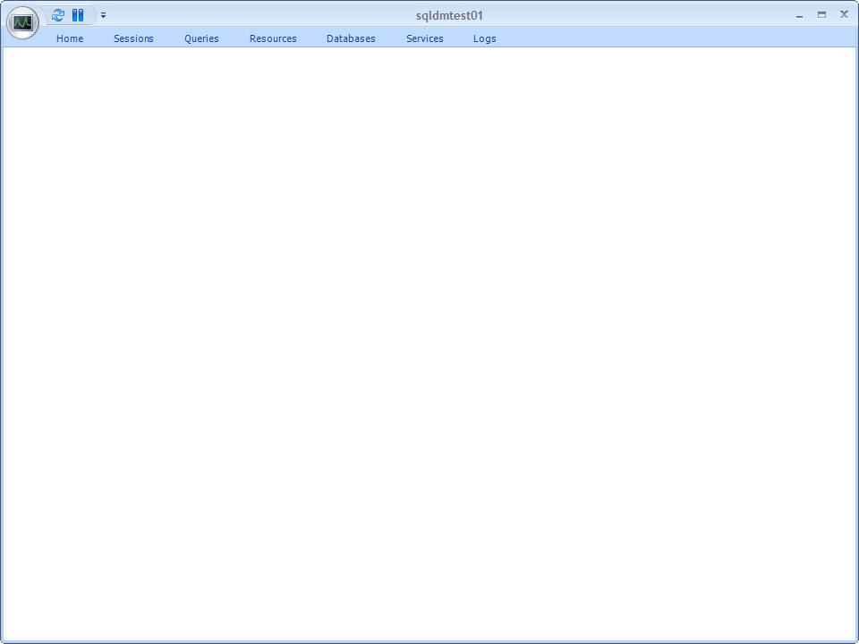

Slide 5
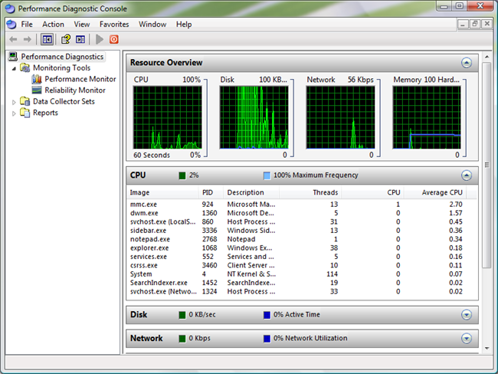

Slide 6
